Slide 1
Full Stack Project review Project Title: PTU Resource Hub
Batch-05
Cegil
Gokulnath P
Hemachandran P

Slide 2
PROBLEM STATEMENT
Student nowadays find it difficult to access the resources available for every topic in the syllabus
Collective information is what is preferred by every student
Hub to share information is lacking in a college environment
The correctness of every information shared is important with respect to sharing these contents
A single person cannot collect all quality resources for a particular topic
With all said, time to gather these resources is the key factor for this problem

Slide 3
OBJECTIVE
To provide all resources related to each topic in an organized manner
To Enable 2-step verification of content and ensuring resource correctness
To provide a Request Forum to ask for new materials and report in case of any discrepancies
To enable admin to manage the request and maintenance part
To provide students functionality of bookmarking the resources to keep track of their progress

Slide 4
TECHNOLOGY STACK
Frontend | Reactjs
Backend | Spring Boot
Database | MySQL
ORM Mapping | JPA(Hibernate)
Testing | Junit, Mockito
Code Coverage | Eclemma

Slide 5
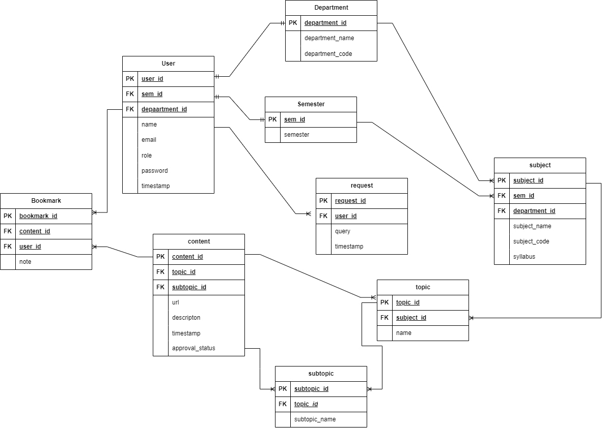
ENTITY-RELATION DIAGRAM

Slide 6
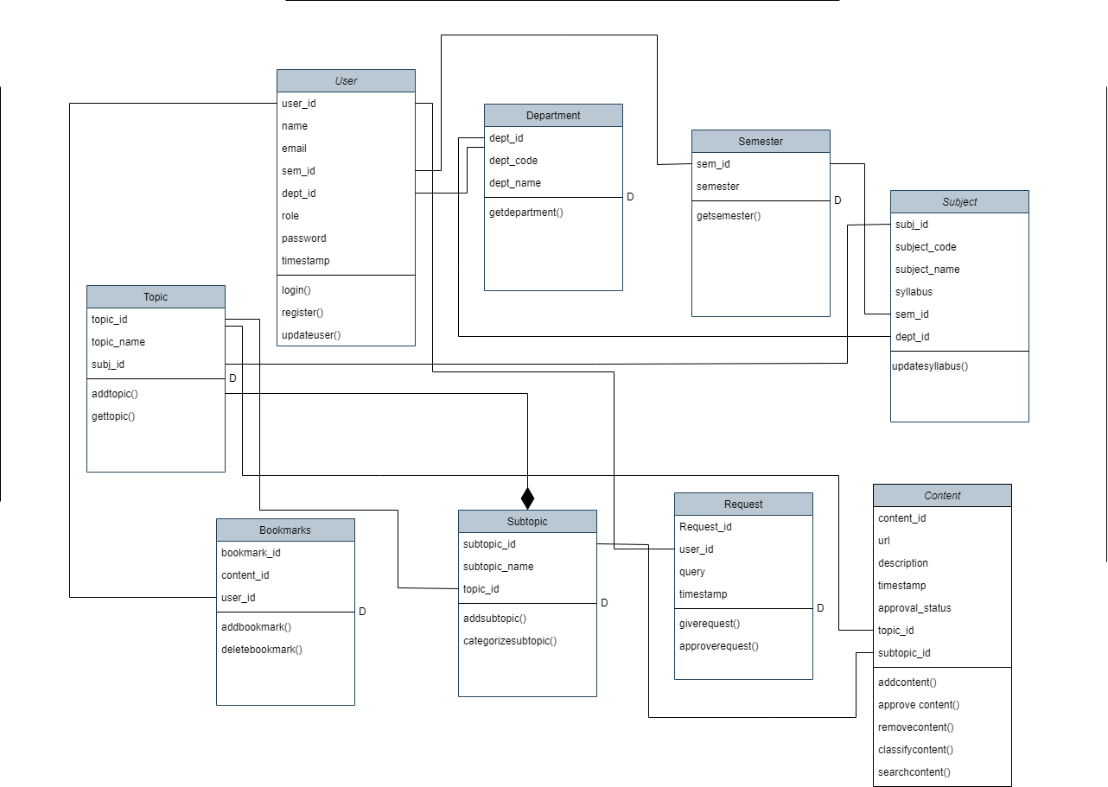
CLASS DIAGRAM

Slide 7
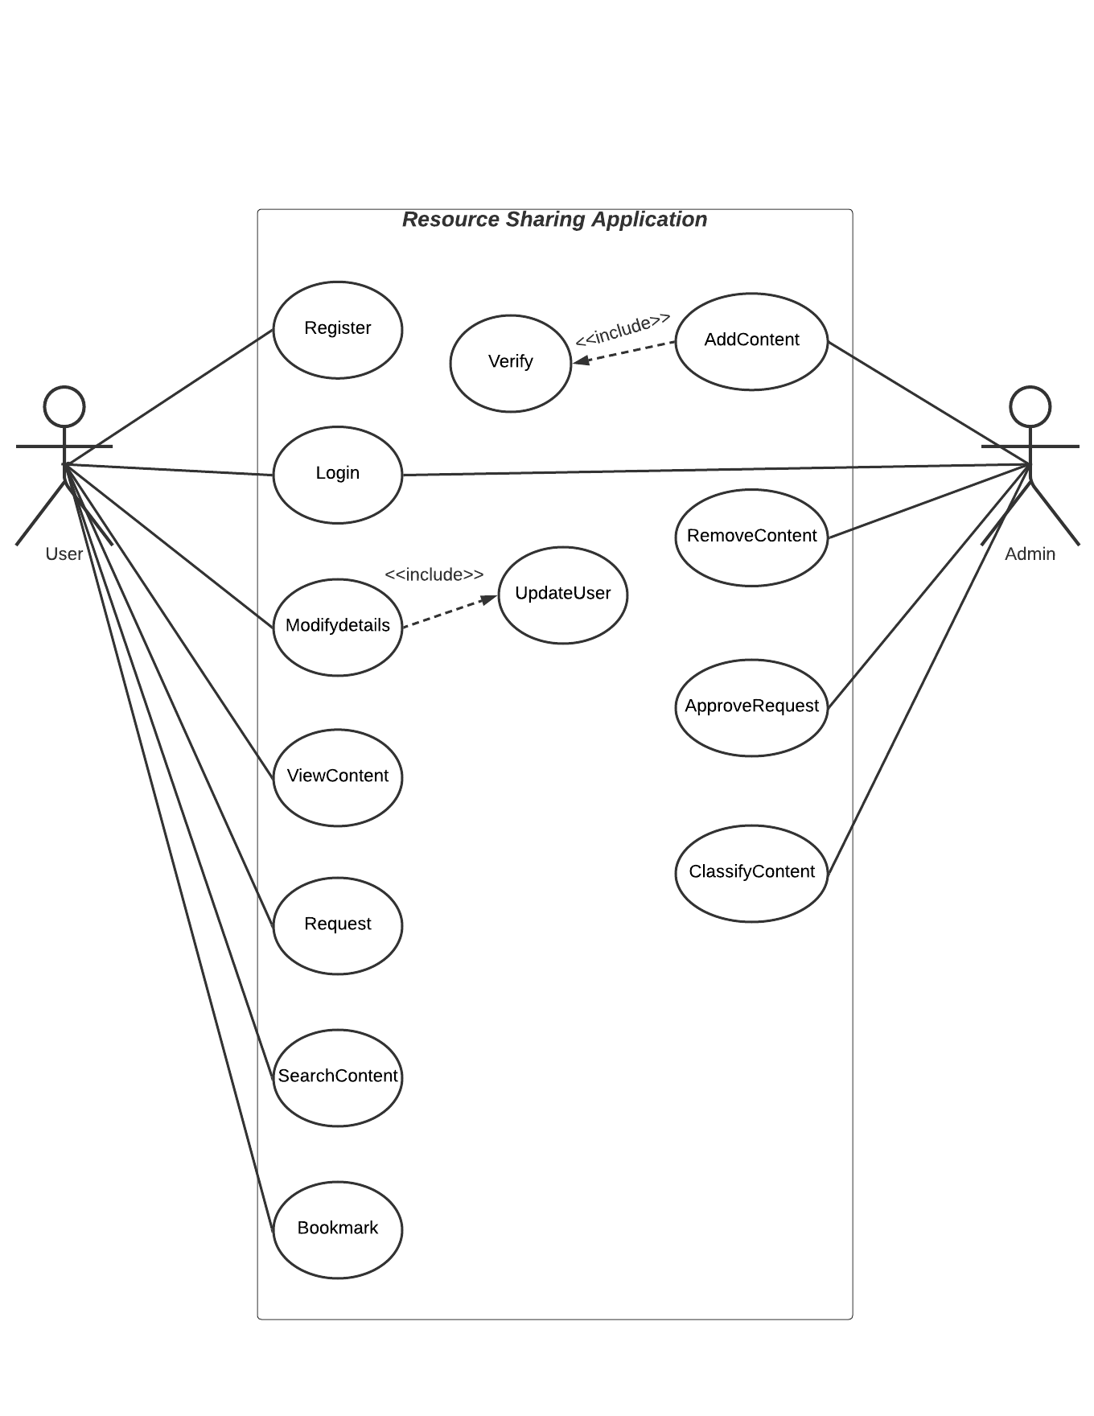
USE-CASE DIAGRAM

